Slide 1
Homomorphic Encryption

Slide 2
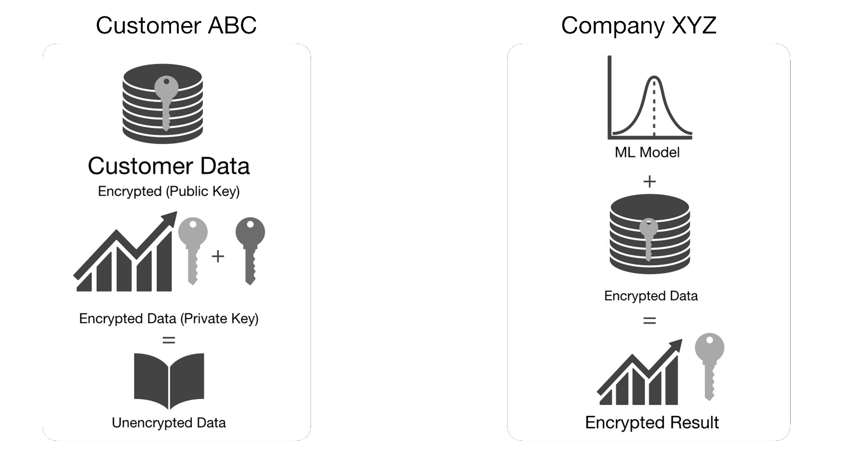
USER A
COMPANY X

Slide 3
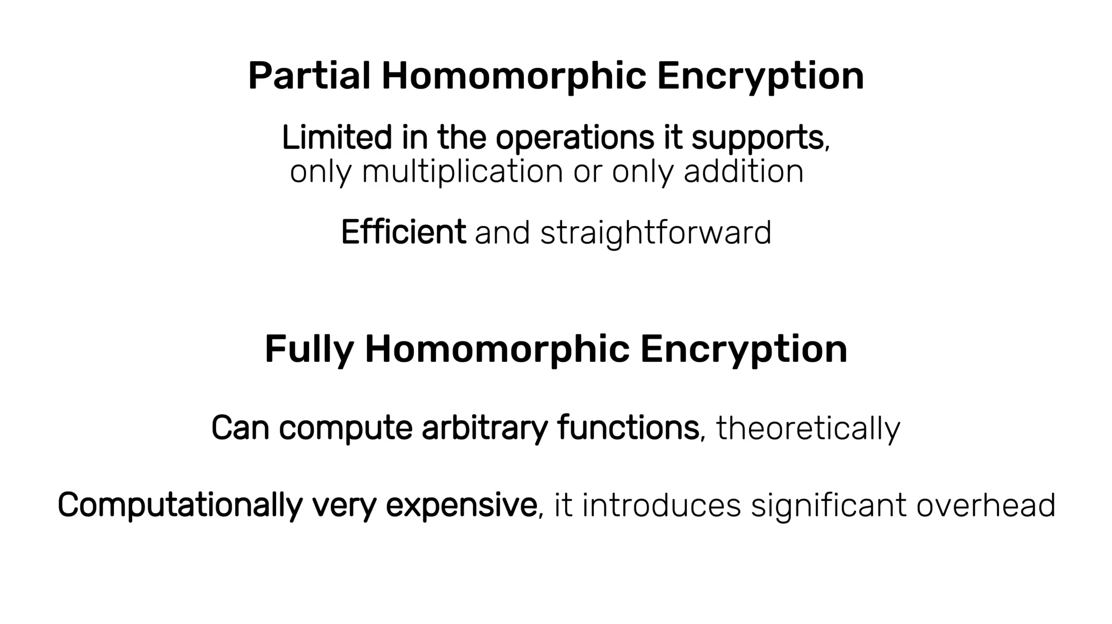

Slide 4



